Slide 1
Stock priceS FORECASTING
Mohammed Faisal BT18GCS067
Somanath Vamshi BT18GCS076
Arjun Bakshi BT18GEC134

Slide 2
Problem Statement
02 Literature Reviews
04
results
03
Proposed methodology
01

Slide 3
Problem statement
The goal of our work is to collect stock prices of companies listed in NSE of India and scrap the news data related to that stock and predict the opening price of the stock.
In this paper we have proposed a hybrid model using ML, DL, and NLP which will be predicting the opening price of the stock based on the past stock prices and the stock news affecting that company.

Slide 4
OBJECTIVES
Technical analysis
Sentiment Analysis
This will include financial data like open value, close value, high, low, volume traded, turnover.
Data will be extracted from pandas library,preprocessed and then feed into the LSTM network to predict the opening price of the stock.
This will include web scraping of news from google news or screener and evaluating the keywords using NLP tools to understand the sentiments of the market and calculate the sentiment score.
These scores will then be added into our dataset.

Slide 5
LITERATURE REVIEW
01
Comparison between ML and DL models
03
Models using NLP data
02
Comparisons between different Deep Learning Models
SVM vs ANNs (combined SVM with PSO optimization)
ARIMA, SARIMA, ANN, CNN and RNN comparisons.[CNN,RNN better]
Findings: ML models are not very accurate for time series data
Sentiment analysis is not considered
LSTM and GRU compared(has inspired our base model)
Feature Engineering in addition to model.
Findings: Stock news carries important data for predictions
Sentiment analysis proves to give better predictions
Variating lookback periods in RNNs
Univariate and multivariate series
Findings: Accuracy of multivariate models lags behind univariate ones.
Sentiment analysis is again not considered

Slide 6





Technology

Slide 7

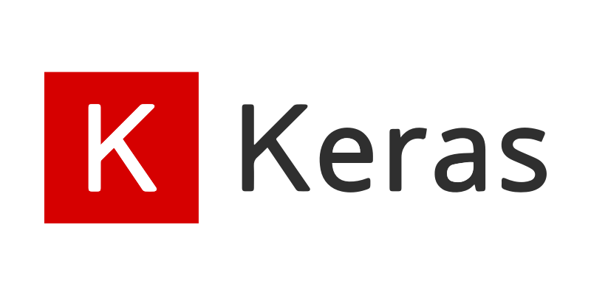
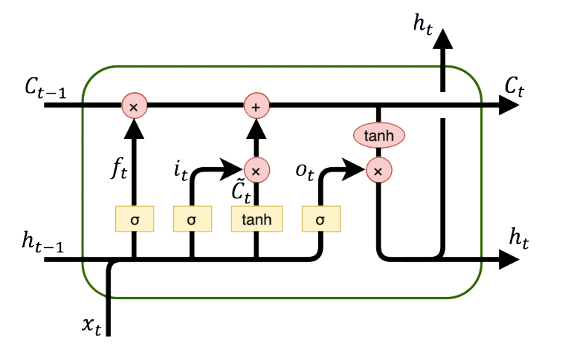
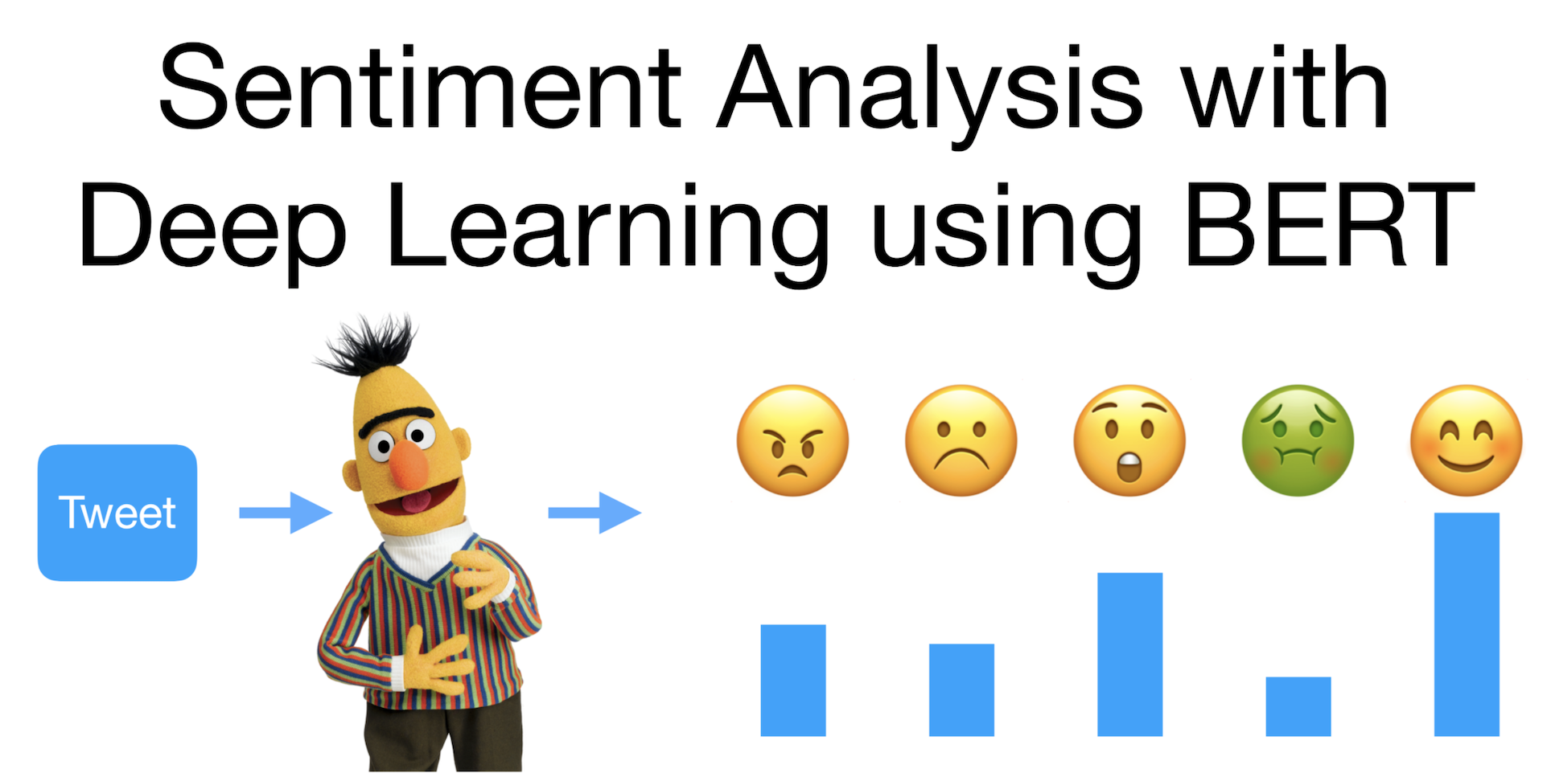
Technology

Slide 8

DATA EXTRACTION
Collection of Data(Technical Analysis):
Historical data of the stock is collected from Yahoo Finance Website which consists of Open, High, Low, Volume Traded, Close price of the stock.
Data taken from 2012 August to 2021 April
Collection of News Data:
News data is collected from Moneycontrol website for that particular day of the targeting stock.
Data is scraped using the beautiful soup library in python.
Data taken from 2012 August to 2021 April

Slide 9
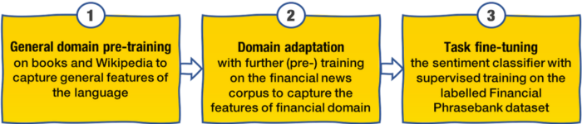
FinBERT
BERT was released recently (October 2018 by Google). FinBERT is BERT fine-tuned specifically for financial sentiment.
This model was used by us primarily due to the failure of VADER to output scores that had correlation with the open prices.
BERT overcomes the challenge posed by RNNs of relating words that are far apart.
It is available pre-trained with a vocab of 30873 words, 12 hidden layers with 768 cells with an hidden activation of ‘relu’ and hidden dropout probability of 0.1.
These are pre-determined for financial sentiments, we have not experimented with parameters or changed the model.

Slide 10
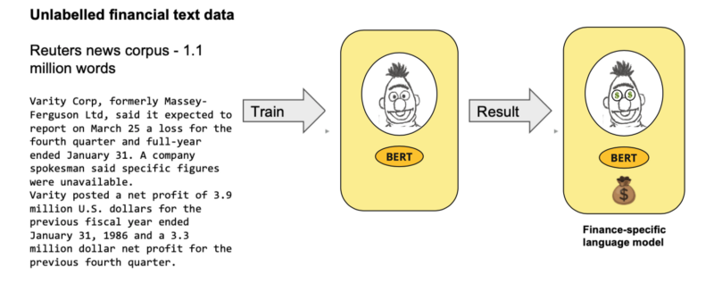
FINBERT
After getting the finbert model we have to give our customised headlines into this bert model then this model predicts the sentiment of the headline .
Like 0: for Neutral , 1: for Positive , -1 : negative
Example: there is a shortage of capital, and we need extra financing
FinBERT predicted sentiment: negative

Slide 11
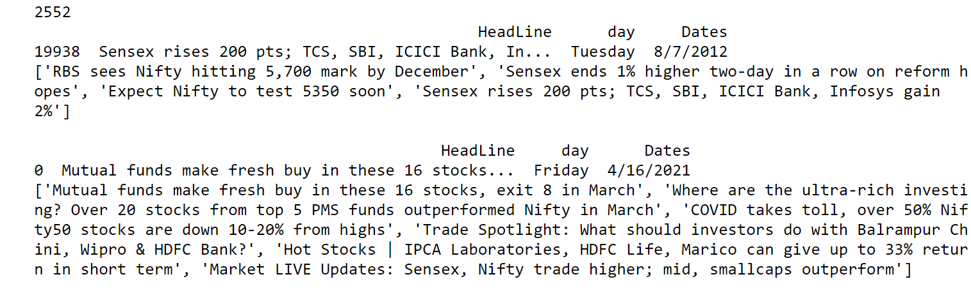
DATA PREPROCESSING
Preparing the Dataset - Getting ready for NLP
After extracting the data(Date, open, close, high, low, volume) and headlines/news of the date range.
Compiling the headlines that were scraped on a particular date into one array.
All such arrays were appended to a bigger array which had the compiled news for each specific date w.r.t to the index within the bigger array.

Slide 12
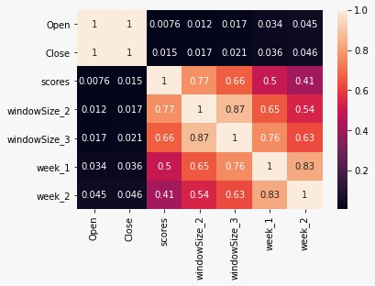
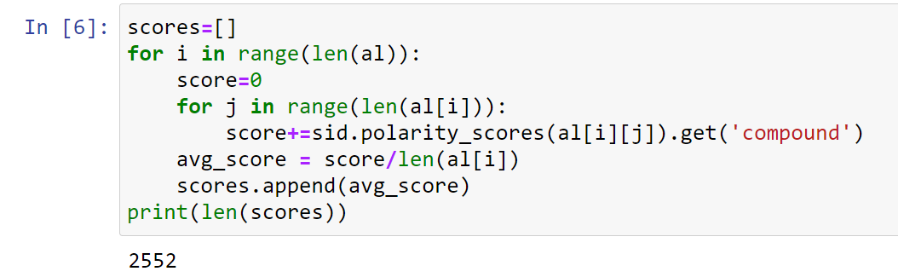
DATA PREPROCESSING
Analysing Results of VADER scores - Concluded its failure, looked for other models
Used VADER from nltk to loop over each headline contained in the respective news array. Compound scores were used.
For each date we took the average of the all the scores returned from all the headlines of that date.
Scores column w.r.t dates was added to dataset.
Correlation between the scores and the target>
Created variations in scores. Hope for better results

Slide 13
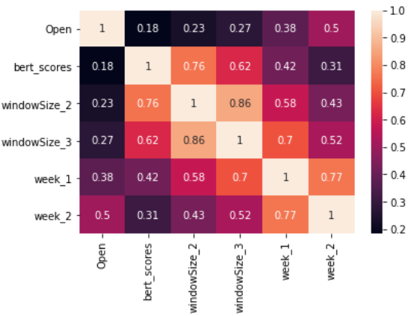
DATA PREPROCESSING
Analysing Results of FinBERT scores - Promising Results, explored weighted averages
Used FinBERT to loop over each headline contained in
the respective array of the news array.
FinBERT : neutral : 0 ; Positive : +1 ; Negative - -1
Averaging similar to VADER(previous slide)
Scores column was then added to our dataset.
Correlation between the scores and the target.
We experimented with the averaging technique
by including weights. Here we gave higher weights to
more recent news(asper dates) by describing a linearly
decreasing function for deciding weights.
Eg for 1 day lagged(total 2days new) : w[x] = 0.66 - 0.33x (x is the index)

Slide 14
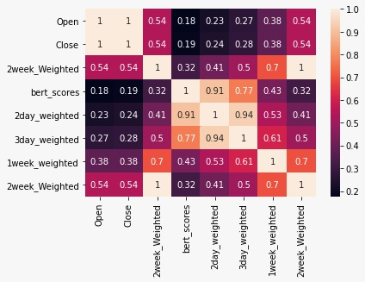
ANALYSIS
Vader Correlation Matrix
FinBERT CORRELATION MATRIX
Low correlation - Column may not provide good information to mode while training
High correlation - Column might provide good information to model while training

Slide 15
DATA PREPROCESSING
Final Step - Dataset Ready
Weight averages gave even better correlation, hence added to dataset.
Observations and predictions with each NLP column have been separately documented and compared later.

Slide 16
Training
Splitting the dataset
Training the model using LSTM,GRU
Prediction

Slide 17
Splitting the dataset
Data set is splitted into two categories one is test and train test from 2008 september to 2021 january. Test form 2021 february to 30 days after that.
While creating the train and test data we are taking the window size of 14 and 7. It is like we are seeing the previous 14 days and predicting the 1 in this way the train x any train y for prediction is prepared . This same applies for 7 day window size.

Slide 18
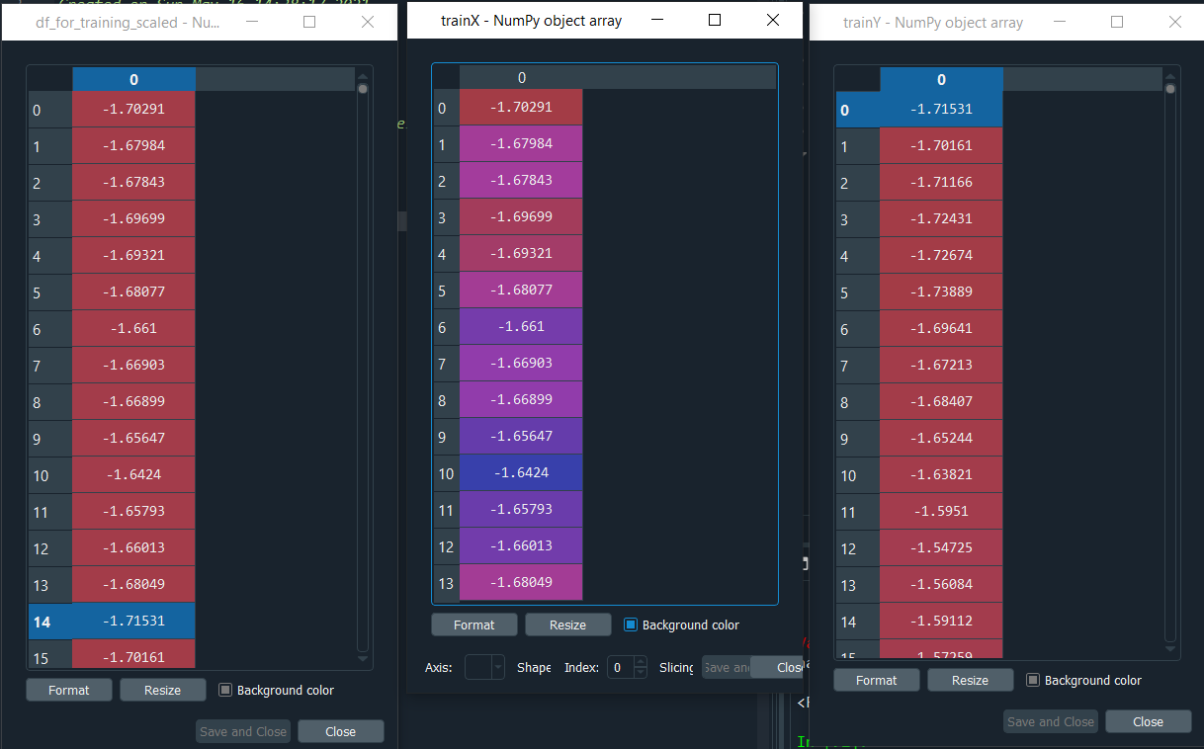
Look back period

Slide 19
Training the model using LSTM,GRU
Long short-term memory (LSTM) is a type of recurrent neural network that allows long-term dependencies in a sequence to persist in the network by using "forget" and "update" gates. It is one of the primary architectures for modeling any sequential data generation process, from stock prices to natural language.
We are training our model on multivariate LSTM(Long short term memory)
In our model we have used on layer of lstm with 120 units , and the activation function is relu . And a dropout layer is added of 0.3 this is used to reduce our model to over fit.
After this layer we have a dense layer with one unit because we are only predicting the open price if the stock.
The model is same for both LSTM and GRU.

Slide 20
CODE DEMONSTRATION
CODE DEMONSTRATION

Slide 21
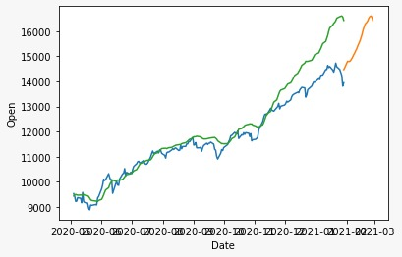
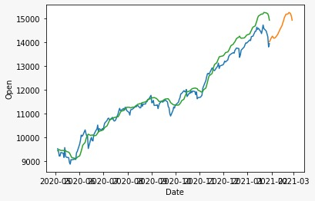
PREDICTIONS
Without Sentiment Analysis
With Sentiment Analysis
Blue - Actual,
Green - Model Training
Yellow - Forecasts
The LSTM model was trained and tested on the Dataset without taking sentiment scores into account.
The LSTM model was trained and tested on the Dataset with taking sentiment scores into account which was calculated by FinBERT

Slide 22
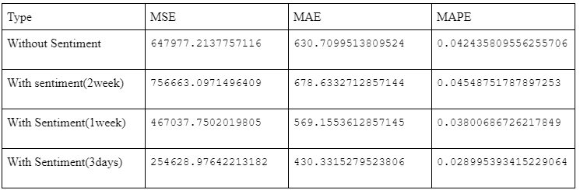
PREDICTIONs
LSTM(with and without sentiment)
Predicted Window - 21 days
Lookback size - 7 days

Slide 23
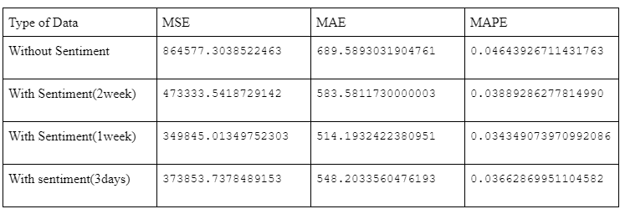
PREDICTIONs
LSTM(with and without sentiment)
Predicted Window - 21 days
Lookback size - 14 days

Slide 24
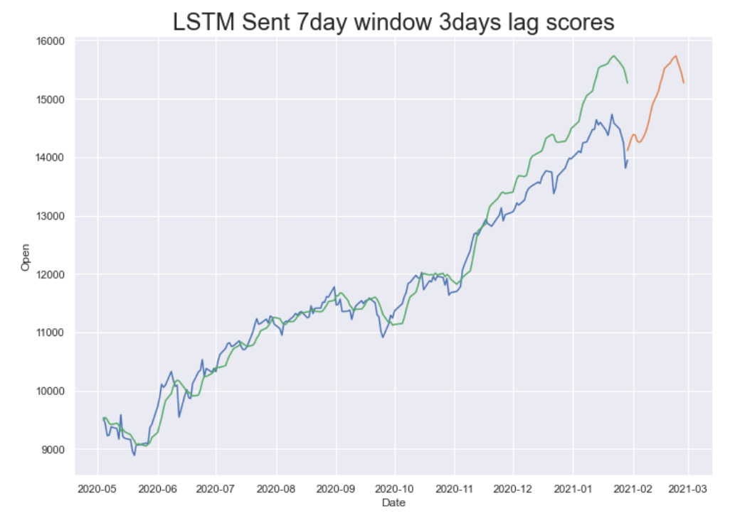
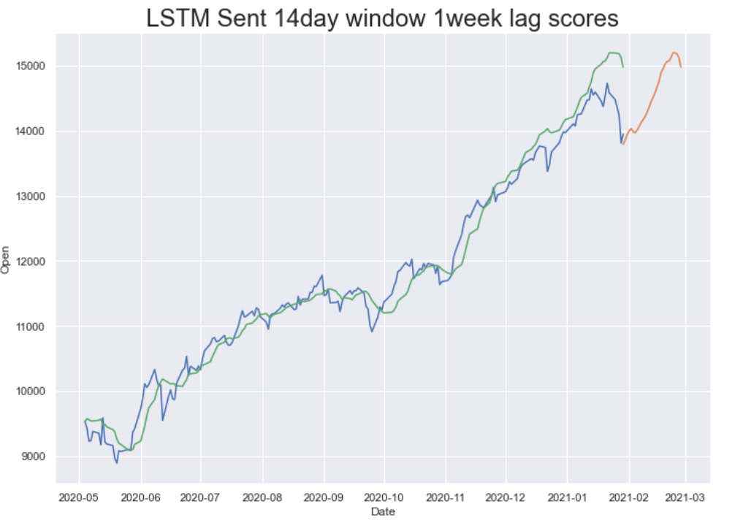
PREDICTIONS
Blue - Actual,
Green - Model Training
Yellow - Forecasts

Slide 25
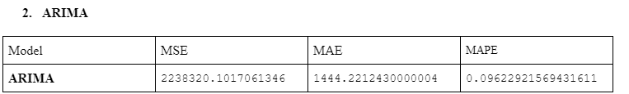
PREDICTIONs
2. ARIMA

Slide 26
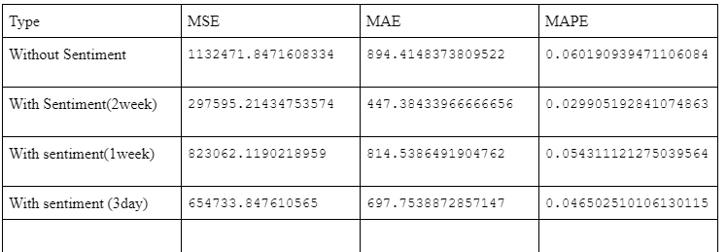
PREDICTIONs
2. GRU(with and without sentiment)
Predicted Window - 21 days
Lookback Size - 7 days

Slide 27
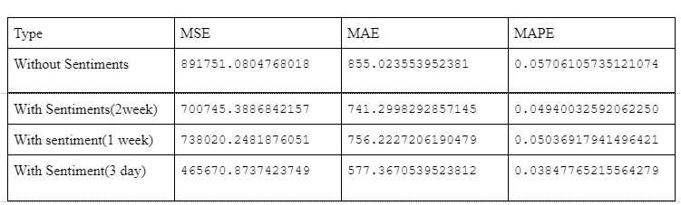
PREDICTIONs
2. GRU(with and without sentiment)
Predicted Window - 21 days
Lookback Size - 14 days

Slide 28
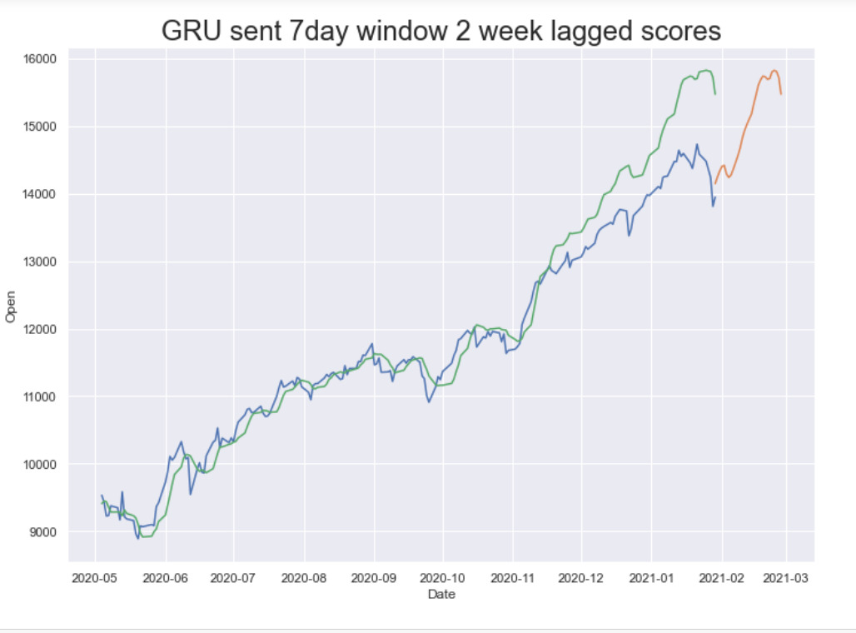
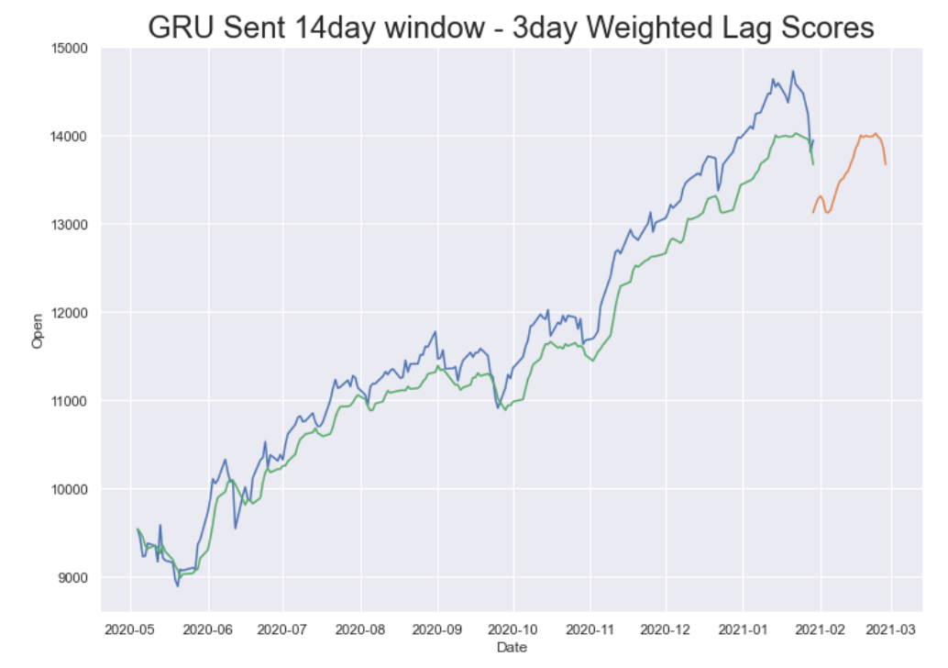
PREDICTIONS
Blue - Actual,
Green - Model Training
Yellow - Forecasts

Slide 29
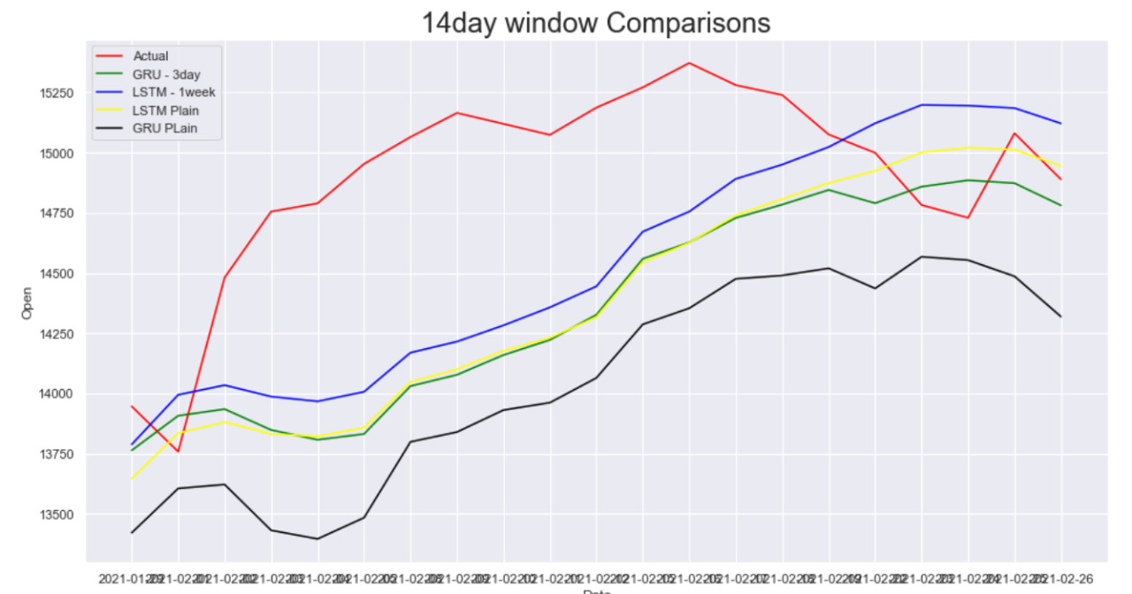
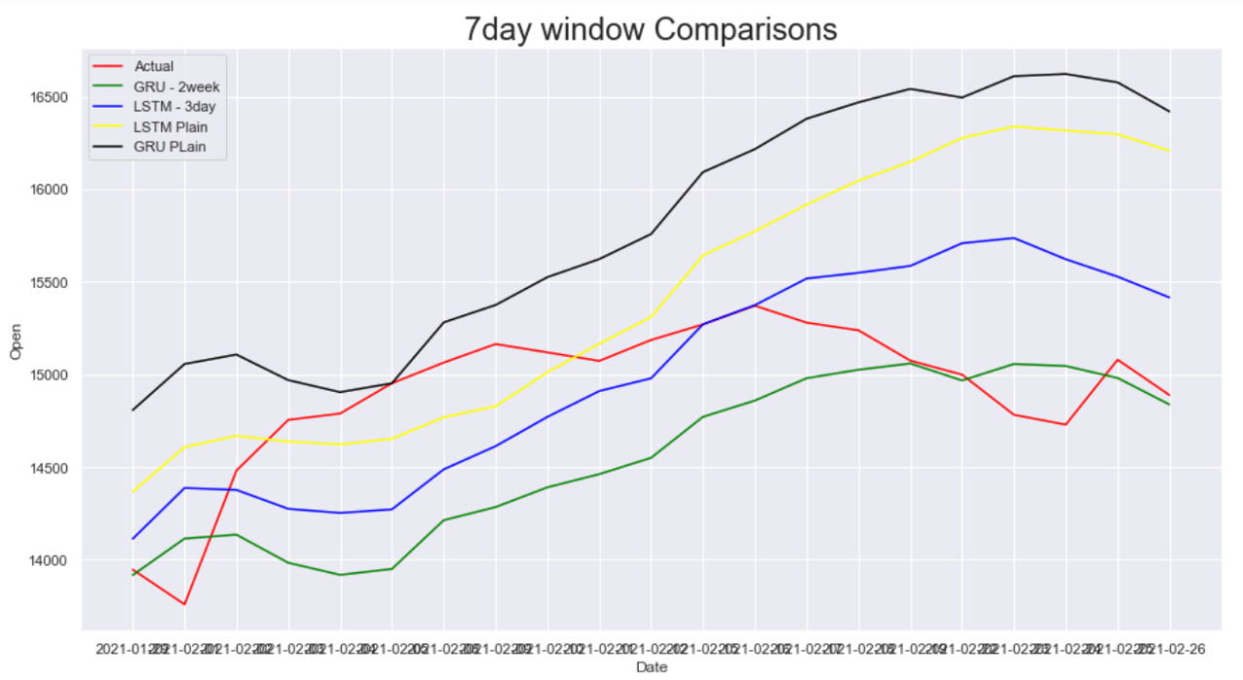
Comparison of models
14 day Window
7 day window
RED - Actual,
Green - GRU sentiment
Blue - LSTM sentiment
Yellow - LSTM without sentiment
Black - GRU without sentiment
LSTM 1 week gave better results compared to remaining models.
LSTM 3 day and LSTM plain gave better results compared to remaining models.

Slide 30

THANK YOU

